Slide 1




STUDENT PERFORMANCE ANALYSIS
TEAM MEMBERS
AMIT KUMAR NAIK
DEEPANJALI SUBUDHI
ABHILASH CHAUDHURY
PADMINI PRIYADARSINI MISHRA
Your paragraph text

Slide 2
PROBLEM STATEMENT
Highlighting the difficulties government schools face while evaluating students' performance across various skills.
Emphasize the lack of data-driven insights to improve educational outcomes by providing solution to these challenges.

Slide 3
INTRODUCTION
In today's dynamic educational landscape, it is crucial to equip educators with the tools needed to effectively assess and develop students' unique skillsets. Standardized testing often fails to capture the full spectrum of student capabilities, leading to missed opportunities for personalized learning and growth.
This project proposes a novel solution: a web-based School Student Performance Analysis System that empowers teachers to collect, analyze, and visualize student data based on individual skillsets.

Slide 4
TECHNOLOGY REQUIREMENT
MS-EXCEL
SNOWFLAKE
POWER BI

Slide 5
PROJECT FLOW
Project Initiation
Project completion
PROJECT FLOW
ETL Process(Extract Transform Load)
Sharing data insights securely with Power BI.
Automating data ingestion from Amazon S3 to Snowflake using the Snowpipe data loading service.
Normalization of Data into Facts and Dimensions.
Leveraging Power BI for data insights and visualization.

Slide 6


PROJECT FLOW
Stage 2
Stage 4
Stage 6
ETL Process (Extract Transform Load )
Normalization of Data into Facts And Dimensions
Sharing data insights securely with Power BI
1
2
3
4
5
6
7
Stage 1
Stage 3
Stage 5
Stage 7
Project Initiation
Automating data ingestion from Amazon S3 to Snowflake using the snow pipe data loading service .
Leveraging Power Bi for data insights and visualization
Project Completion

Slide 7
DATA FLOW
1. Data Collection
Identify data sources: This could include school management systems, assessment platforms, attendance records, and potentially external data sources like demographic information.
Develop data extraction methods: Build functionalities or use existing tools to extract data from each source in its specific format.
2. Data Integration and Preprocessing:
Data validation: Cleanse and validate the extracted data to ensure accuracy and consistency.
Data standardization: Transform data into a unified format regardless of its original source.
Data enrichment: Consider joining data with additional sources for holistic analysis, such as linking student IDs to external demographic databases.
3. Data Storage and Management:
Choose a data warehouse: Select a platform like Snowflake to efficiently store and manage your growing data volume.
Design a data warehouse schema: Create a well-structured schema using snowflake models to optimize data analysis.
Implement data loading mechanisms: Develop functionalities to load the transformed data into your chosen data warehouse platform.
4. Data Analysis and Visualization:
Prepare data for analysis: Aggregate, calculate metrics, and transform data as needed for specific analysis questions.
Develop visualizations: Create dashboards and reports in Power BI or other tools to communicate insights effectively.
5. Action and Iteration:
Present your visualizations and insights to stakeholders for informed decision-making.
Use the insights to improve teaching methods, identify at-risk students, or track progress towards educational goals.

Slide 8
TABLE DETAILS
TABLE NAME | COLUMN NAME
School_Details | School_ID School_Name Location School_mail Education_Boards Schools_Type
Student_Details | Student_ID Student_Name Date Of birth Gender Grade_Level Contact_Information School_ID School_Name
Skill_Details | Student_ID Skill_Category Skill_Name Skill_Achievement
Student_Performance | Student_ID Formative_Assessment Summative_Assessment Assessment_Avg_Score Grade/GPA Attendance_Rate Attendance_Report

Slide 9
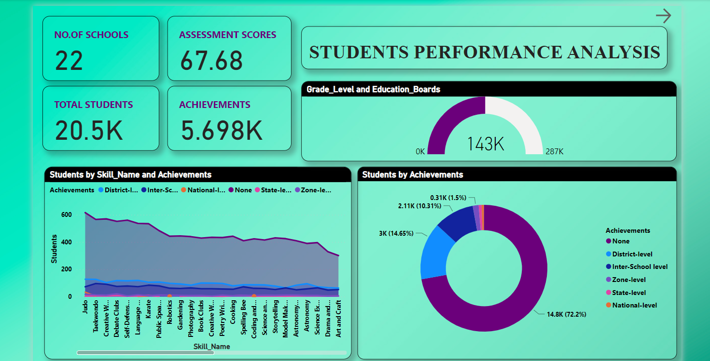
PROJECT VISUALIZATION

Slide 10
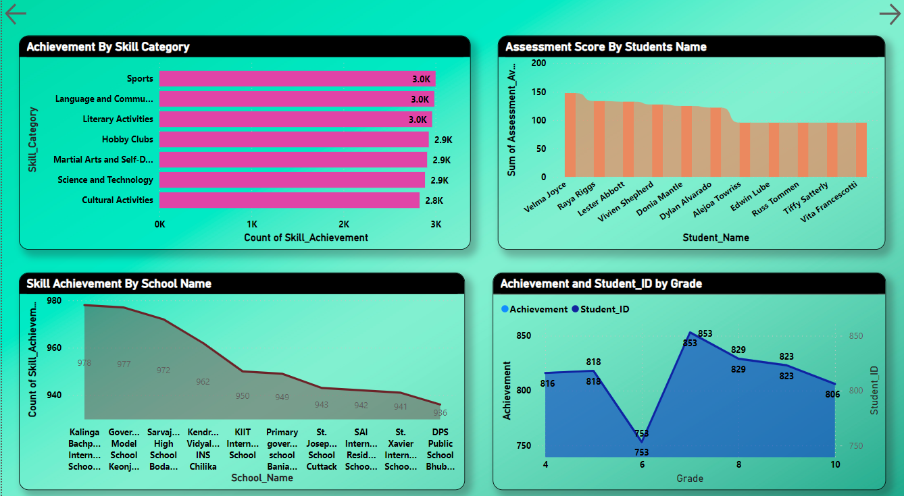
PROJECT VISUALIZATION

Slide 11
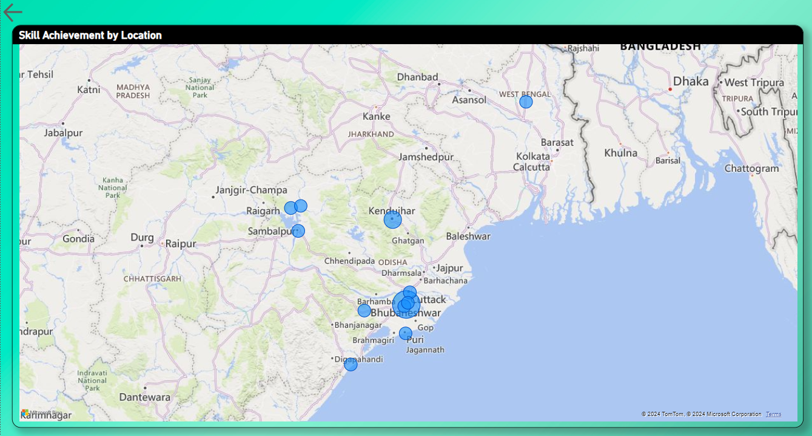
PROJECT VISUALIZATION

Slide 12
BENIFITS
Improved student learning through targeted interventions based on skill levels.
Data-driven decision making for educators and policymakers.
Enhanced educational outcomes and student performance.
Increased transparency and accountability in government schools.

Slide 13
EXPECTED OUTCOMES
Improved student performance
Enhanced data-driven decision making
Increased transparency and accountability

Slide 14
FUTURE SCOPE
Integration with existing school systems
Personalized learning recommendations
Development of customized skill assessments
Feedback Mechanisms

Slide 15
CONCLUSION
This project has the potential to significantly impact the educational landscape by providing schools with a powerful tool for collecting, analyzing, and visualizing student data. By leveraging the power of technology and data analytics, this platform can help schools improve student performance, enhance decision-making, and create a more personalized and effective learning environment for all students.

